Slide 1
Lesson 8:
Programming in Python

Slide 2
Introduction to
Object Oriented Programming

Slide 3
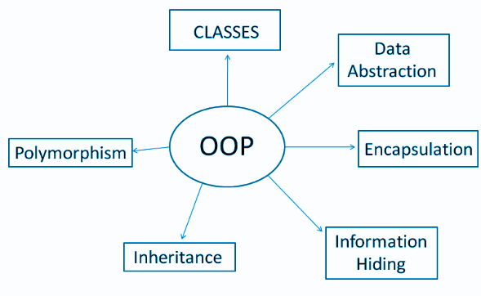

Slide 4
By the end of this segment you will be able to:
Define what is a class
Describe how to create a class
Define what is a
Attribute
Method
Class Variable
Describe how to do object instantiation
Describe how to create instance attributes in Python

Slide 5
Terminologies
Class − A user-defined prototype for an object that defines
A set of Attributes that characterize any object of the class and
Methods, accessed via dot notation.
Attributes − A class variable or instance variable that holds data associated with a class and its objects.
Method − A special kind of function that is defined in a class definition.
Object − A unique instance of a data structure that's defined by its class. An object comprises both data members (class variables and instance variables) and methods.
Instantiation − The creation of an instance of a class.
Class variable − A variable that is shared by all instances of a class. Class variables are defined within a class but outside any of the class's methods. Class variables are not used as frequently as instance variables are.
Constructor/Destructor

Slide 6
Python Classes and Methods
Python is an “object-oriented programming language.” This means that almost all the code is implemented using a special construct called classes. Programmers use classes to keep related things together. This is done using the keyword “class,” which is a grouping of object-oriented constructs.

Slide 7
What is a class?
A class is a Blueprint for creating objects. Objects have member variables and have behaviour associated with them. In python a class is created by the keyword class.
An object is created using the constructor of the class. This object will then be called the instance of the class. In Python we create instances in the following manner
Instance = class(arguments)

Slide 8
How to create a class?
The simplest class can be created using the class keyword. For example, let's create a simple, empty class with no functionalities.
class Student:
Pass
new_student = Student()
print(new_student)

Slide 9
Attributes and Methods in class:
A class by itself is of no use unless there is some functionality associated with it.
Functionalities are defined by setting attributes, which act as containers for data and functions related to those attributes. Those functions are called methods.

Slide 10
Class Variable
You can define the following class with the name Student. This class will have an class variable name.
class Student:
name = "Tommy" # set an attribute `name` of the class
You can assign the class to a variable. This is called object instantiation. You will then be able to access the attributes that are present inside the class using the dot . operator. For example, in the Student example, you can access the class variable name of the class Student.
# instantiate the class Student and assign it to variable "Tommy"
new_student = Student()
# access the class attribute name inside the class Snake.
print(new_student.name)

Slide 11
Methods
Once there are attributes/class variables that “belong” to the class, you can define functions that will access the class attribute. These functions are called methods. When you define methods, you will need to always provide the first argument to the method with a self keyword. For example, you can define a class Student, which has one class variable name and one method change_name. The method change_name will take in an argument new_name along with the keyword self.
class Student:
name = "Python" # set class variable `name` of the class
def change_name(self, new_name): # note that the first argument is self
self.name = new_name # access the class attribute with the self keyword

Slide 12
Methods(Contd.)
Now, you can instantiate this class Student with a variable “Tommy” and then change the name with the method change_name.
# instantiate the class
new_student = Student()
# print the current object name
print(new_student.name)
# change the name using the change_name method
new_student.change_name("Jamie")
print(new_student.name)

Slide 13
Instance attributes in python and the init method
First let’s learn about constructor Constructor comes from the word construction. The constructor builds a class by giving it initial properties and data. Here's how we define a constructor:
The function __init__() is a constructor. a, b, c are the values to which the class object is initialised. These values are given as an input while creating a class object.
class ClassName:
def __init__(self, a, b, c):
self.var1 = a
self.var2 = b
self.var3 = c

Slide 14
Instance attributes in python and the init method(contd.)
Now you can directly define separate attribute values for separate objects. For example,
class Student:
def __init__(self, name):
self.name = name
def change_name(self, new_name):
self.name = new_name
student1 = Student("Jack")
student2 = Student("Duke")
print(student1.name)
print(student2.name)

Slide 15
Let’s check our understanding
Let’s create a class Employee.
Create a class variable total_employee and initialize it to zero.
Define init method and initialise name and salary of the employee. Also increment the total_employee.
Define a function display_employee to display all the information of the employee.
Define a function display_count to display total_employee

Slide 16
Example
class Employee:
total_employee = 0
def __init__ (self, name, salary):
self.employee_name = name
self.employee_salary = salary
Employee.total_employee += 1
def display_employee(self):
print(self.employee_name + " " + str(self.employee_salary))
def count_total(self):
print(Employee.total_employee)
emp1 = Employee("John", 24000)
emp1.display_employee()
emp1.count_total()
emp1 = Employee("Jenna", 26000)
emp1.display_employee()
emp1.count_total()

Slide 17
We’ll continue in next class..
Any questions?

